Slide 1

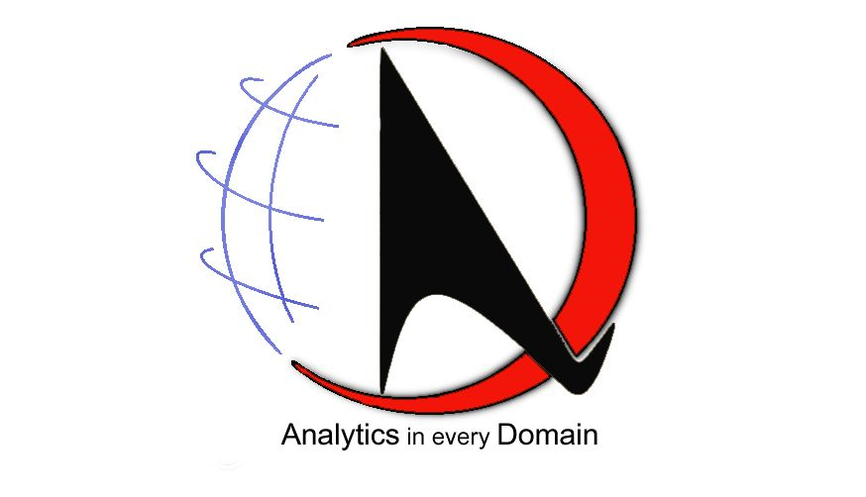
ANALYTICS DOMAIN
CLUSTERING
Analytics in Every Domain

Slide 2

Our Vision
ANALYTICS DOMAIN
Analytics Domain believes that the application and study of Analytics will pervade all aspects of Life sooner or later.
Our Mission
To Develop High End AI &Analytical products
Give Consultation to organizations who want to apply Analytics to improve their processes
Deliver cutting edge trainings on Artificial Intelligence, Machine Learning and Big Data Analytics.

Slide 3



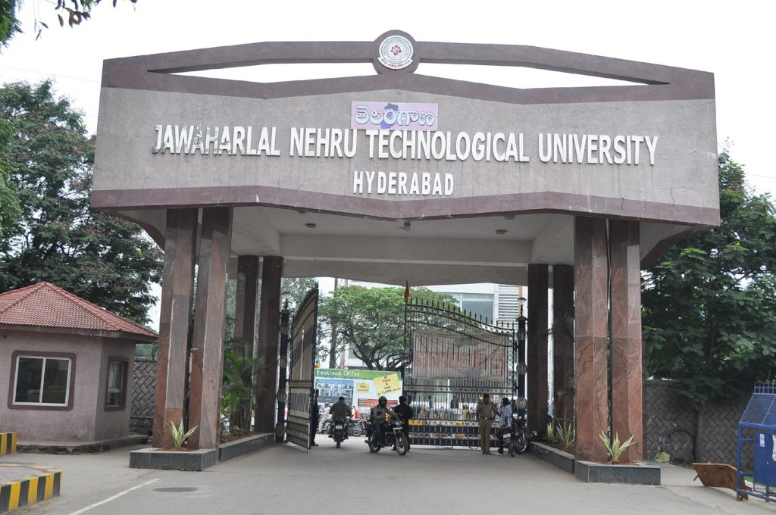











Analytics Domain

Slide 4
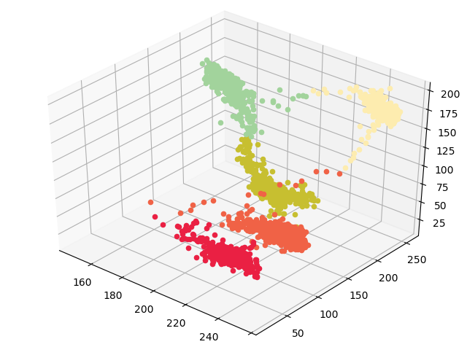
CLUSTERING
Machine Learning Model
1. Unsupervised Learning
2. Cluster Analysis Introduction
3. Interpreting the cluster analysis results
4. Univariate characterization
5. Multivariate characterization
6. Conclusion

Slide 5
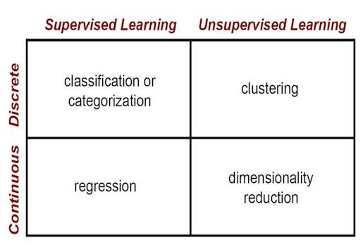
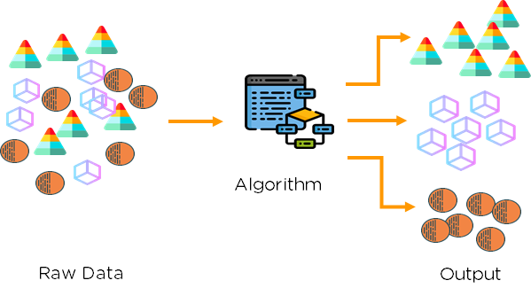
UNSUPERVISED LEARNING

Slide 6
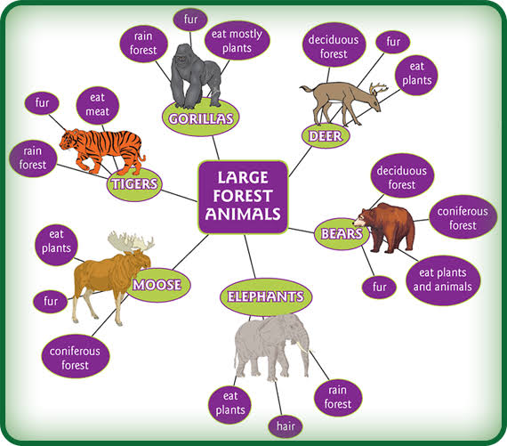
CLUSTER ANALYSIS
Multivariate method
Cluster objects
Cluster on the basis of a set of measured variables
Into a number of different groups such that
Similar objects are placed in the same group

Slide 7
Interpretting clustering analysis results

Slide 9





Thank You
Moushmi Dasgupta
+91 9673993020
info@analyticsdomain.com
www.analyticsdomain.com

